Slide 1
A Trauma-Informed Approach
Gary Rukin, MA, MS, LPC
Trauma-Informed Coordinator, McHenry County Mental Health Board

Slide 2
Why
Looking at life through a trauma-informed lens allows us to better understand and relate to ourselves and each other.
Notes:
Once we begin to understand why we act as we act and think as we think, self-hatred and internal stigma lose their grip on us.
Once we begin to understand why others act as they act and think as they think, compassion and empathy replace condemnation.
This is how a trauma-informed lens changes us.

Slide 3
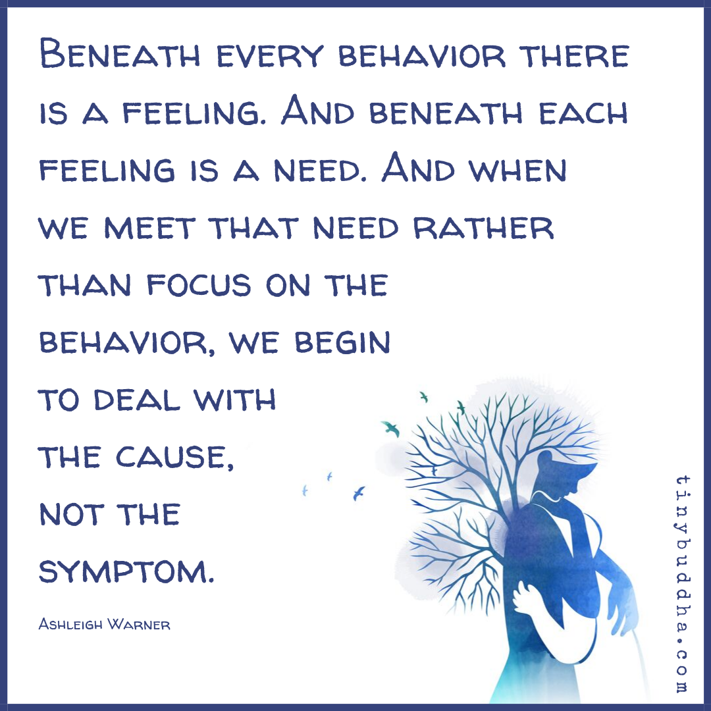

Slide 4
“You shift the frame, you change the lens, and all at once the world is revealed and nothing is the same.”— Dr. Nadine Burke Harris, M.D.

Slide 5
What is Trauma?
Trauma can either be physical or emotional.
Physical trauma is a serious bodily injury.
Emotional trauma is the emotional response to a disturbing event or situation.

Slide 6
Types of Trauma include, but are not limited to:
Child abuse
Child neglect
Bullying
Physical abuse
Domestic violence
Violence in the community
Natural disasters
Medical trauma
Sexual abuse
Sex trafficking
Substance use
Intimate partner violence
Verbal abuse
Accidents
War
Refugee trauma
Terrorism
Traumatic grief
Intergenerational trauma

Slide 7
Psychological Symptoms of Emotional Trauma
Fear
Helplessness
Dissociation
Changes in attention, concentration, and memory
Changes in behavior
Changes in attitude
Changes in worldview
Difficulty functioning
Denial—
Refusing to believe the trauma occurred
Anger
Bargaining
Avoidance
Depression
Anxiety
Mood swings
Guilt or shame
Blame (including self-blame)
Social withdrawal
Loss of interest in activities
Emotional numbness

Slide 8
Physical Symptoms of Emotional Trauma
Increased heart rate
Body aches or pains
Tense muscles
Feeling on edge
Jumpiness or startling easily
Nightmares
Difficulty sleeping
Fatigue
Sexual dysfunction
Appetite changes
Excessive alertness

Slide 9
The Underlying Pathophysiology of Trauma
Thomas Rutledge writes, “Modernity…has exposed us to a problem that our ancestors and evolutionary biology rarely encountered: chronic stress.
Instead of the historically normal process of HPA axis activation followed by rest and recovery, modern traumas and stressful events frequently result in a fight-or-flight response that may be sustained for months or even years.”

Slide 10
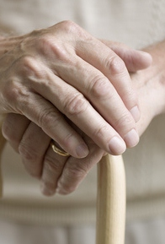
A Trauma-Informed Approach
Aims to avoid re-victimization
Appreciates that problem behaviors may be attempts to cope
Strives to maximize choices for the survivor and control over their own healing process
Seeks to be culturally competent

Slide 11
SAMHSA/CDC Six Principles of Trauma-Informed Care

Slide 12
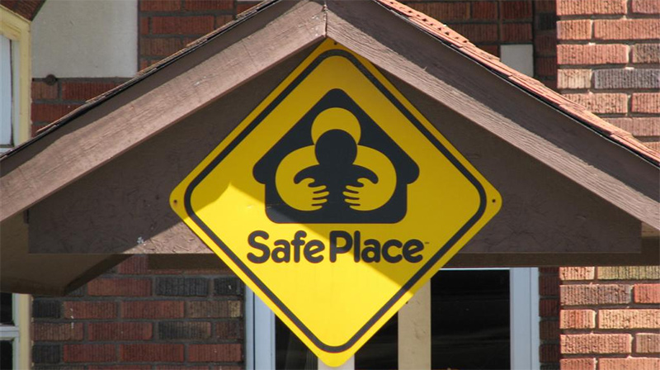
SAMHSA/CDC Six Principles of Trauma-Informed Care
SAFETY
Throughout the organization, staff and the people they serve, whether children or adults, feel physically and psychologically safe.
The physical setting is safe and interpersonal interactions promote a sense of safety.
Understanding safety as defined by those served is a high priority.

Slide 13
SAMHSA/CDC Six Principles of Trauma-Informed Care
Trustworthy & Transparency
We build and maintain trust with people served by our organization and their family members, among staff and leadership, and with all other stakeholders and partners.
We have a culture of honesty, where people follow through on their commitments to each other and the people we serve.
This Photo by Unknown Author is licensed under CC BY

Slide 14
SAMHSA/CDC Six Principles of Trauma-Informed Care
Peer Support
We value the insights and knowledge of people with lived experiences of trauma.
If we’re working with children, we strive to involve adults who experienced trauma and children or family members of children who experienced traumatic events.
We include peers in service delivery and ensure they have input into how services are designed and offered.

Slide 15
SAMHSA/CDC Six Principles of Trauma-Informed Care
Collaboration & Mutuality
We value partnering and leveling power differences between ourselves and the people we serve and among organizational staff, recognizing that healing happens in relationships and in the meaningful sharing of power and decision-making.
Everyone, especially the people we serve, has a role to play in deciding what services are needed and how they are delivered.
We promote a sense of control and agency in others.

Slide 16
SAMHSA/CDC Six Principles of Trauma-Informed Care
Empowerment, Voice, & Choice
We recognize and celebrate the strengths of others and uphold the centrality of the people we serve.
We believe in resilience, and in the ability of individuals, organizations, and communities to heal, and we focus on shared decision-making, identify and offer choices for service delivery, and listen to understand the meaningful goals of the people we serve.

Slide 17
SAMHSA/CDC Six Principles of Trauma-Informed Care
Cultural, Historical, & Gender Issues
We acknowledge and respond to cultural, historical, and gender issues, balancing the need to understand, honor, and respond to cultural and intersectional differences and offer culturally competent and gender responsive services while at the same time moving past cultural stereotypes and biases in our expectations and service delivery.

Slide 18
Why Use a Trauma-Informed Approach:

Slide 19
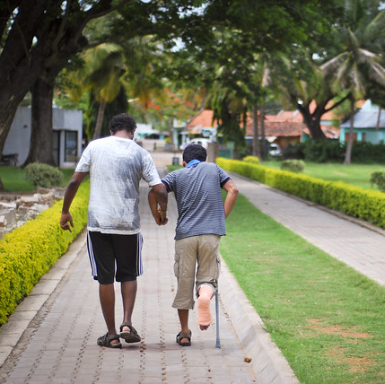
Trauma is Often Invisible
When we see someone with a broken leg, we know they are impaired, and will often strive to make their lives easier by holding a door open or offering to carry their packages.

Slide 20
Trauma is Often Invisible
When someone appears angry or out of control, we often react in kind.
Someone with a history of trauma may be dysregulated.
Kindness & understanding are likely to be more helpful in resolving the situation and allowing the person to be heard.

Slide 21
Gabor Maté, M.D. with Steven Bartlett: Trauma is Invisible

Slide 22
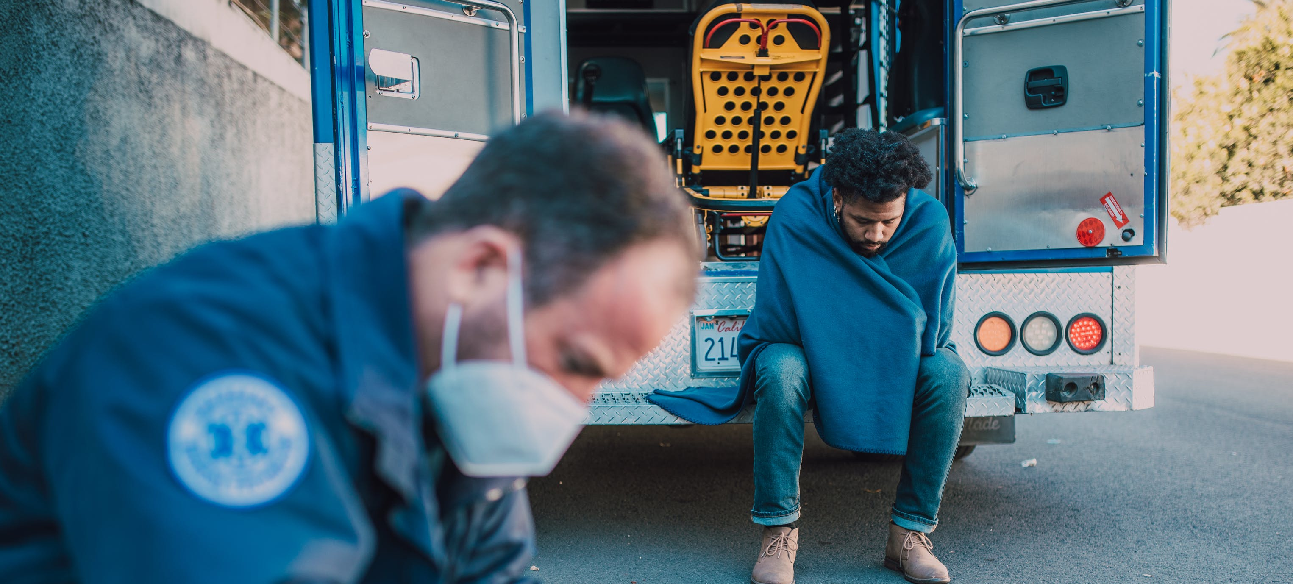
Learning Brain vs. Survival Brain
When a child comes to school and we ask her to sit still, share, and cooperate, there can be a painful disconnect.
The child will have to be taught the skills required to succeed in this context just as we would train a person from a more benevolent path how to conduct themselves in a chaotic and dangerous environment.

Slide 23
Learning Brain vs. Survival Brain

Slide 24
We All Come from Somewhere
A Legacy of Trauma
Notes:
None of us came into this world with a blank slate. Not only did we inherit traits from our parents, we also inherited behaviors.
To understand the forces which shape us, we need to go back, to before we were born, before our parents met, even before they were born.
Back to the generations which shaped your parents, your grandparents, & began that magical journey which led to you.

Slide 25
Some Triumph Against All Odds
At 5 feet and 3 inches, Mugsy Bogues was an unlikely basketball star.
The shortest player ever to compete in the NBA, Bogues played point guard for four teams during his 14-season NBA career.
He had 146 NBA career double-doubles.
This Photo by Unknown Author is licensed under CC BY-SA-NC
Notes:
Bogues was born in Baltimore, Maryland, and grew up in the Lafayette Court housing projects. At five years old, he was hit by stray buckshot in his neighborhood and had to be hospitalized. As a child, he witnessed a man get beaten to death with a baseball bat, a sight that haunted him into adulthood. When Bogues was 12 years old, his father was sentenced to twenty years in prison for armed robbery. Around the same time, his brother Chuckie began using hard drugs.

Slide 26
Some Triumph Against All Odds
Frederick Douglass was born into slavery & separated from his mother at a young age.
He was beaten severely for teaching himself to read.
He escaped from slavery, led the abolitionist movement, and gained notoriety for his oratory and antislavery writing.
Douglass’ autobiography is Narrative of the Life of Frederick Douglass, an American Slave.

Slide 27
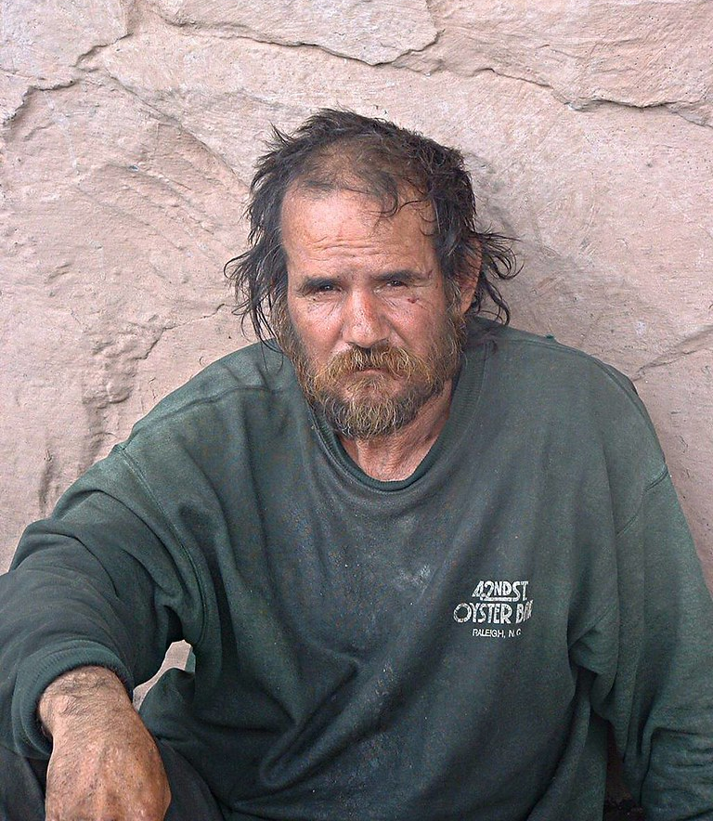
Many Do Not
This Photo by Unknown Author is licensed under CC BY
Notes:
While we know the stories of the famous and the infamous, there are others whose stories never make the news or reality television shows, and some never make it at all.

Slide 28
Epigenetics
There was an experiment done with mice and cherry blossoms, which demonstrates how a reaction to trauma may be passed down for generations.

Slide 29
Inheritance
Think about your family traditions, passed down from one generation to another.
the holidays you celebrate
the foods you eat
the way you choose to name your children.
These and more are legacies each of us has inherited.
Notes:
Though you have the ability and resources to create your own traditions, these traditions, passed down from generation to generation, have shaped you, and in your acceptance of, or other reactions to these traditions, you will shape your children’s lives.

Slide 30
Inheritance
We not only inherit recipes and family heirlooms, but sensitivities and methods of coping as well.
We don’t merely study history, we live it.
Notes:
Just as we are shaped by the observable heritage that culminated in our lives, so we are shaped by the forces which shaped the generations before us, both visible and invisible.

Slide 31
Epigenetics

Slide 32
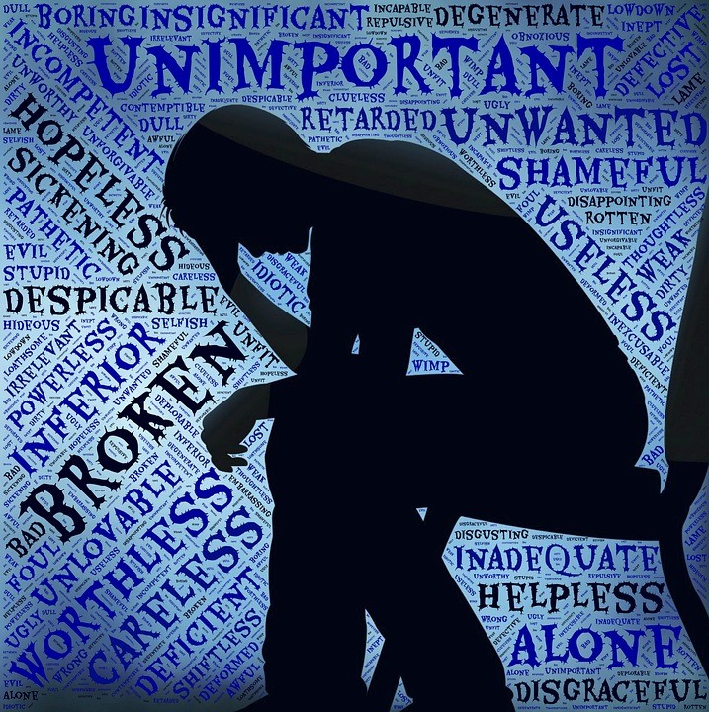
Epigenetics
The unacknowledged terrors of one generation may lead to neglect in the next.
These historical traumas inform decisions about who we can and cannot trust, as well as what we do, and do not believe.
This Photo by Unknown Author is licensed under CC BY
Notes:
As human beings, we seek pleasure and avoid pain. These forces create patterns in the generations which came before us, and are passed down in the behaviors we observe, and in the beliefs with which we were raised, as well as in the very fabric of our genetic makeup.

Slide 33
Bayview Child Health Center
This Photo by Unknown Author is licensed under CC BY
Notes:
In 2007, Dr. Nadine Burke Harris founded the Bayview Child Health Center in San Francisco’s Bayview Hunter’s Point neighborhood and discovered how severely early adversity was harming the developing brains and bodies of the children she was charged with treating.
She realized these children were suffering not only mental health symptoms, difficulty concentrating and acting out at home and in school, but physical illnesses as well, growth below expected milestones, obesity, skin disease and diabetes.

Slide 34
Tadpoles & Toads
The Hayes Laboratory Connection
Notes:
Dr. Burke Harris, who went on to become the first surgeon general of the State of California, did graduate work at the Hayes Lab, and knew to look at stress in a place where it was all too common.

Slide 35
Researchers at the Hayes Lab studied the maturation of tadpoles to toads while dosing them with steroid hormones.
They noticed how the tadpole's growth & later metamorphosis had been affected.

Slide 36
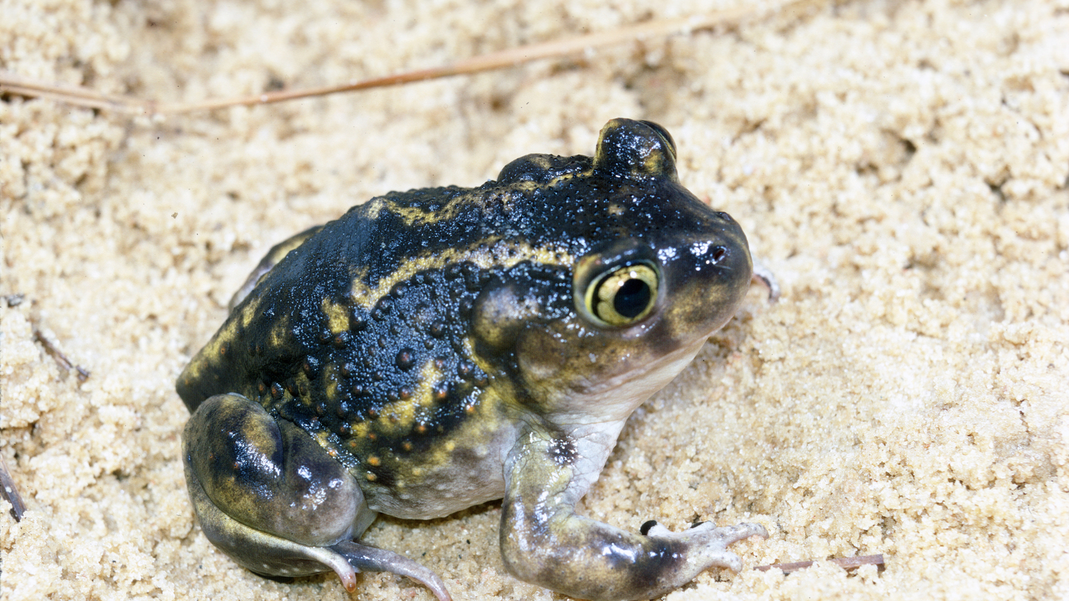
If the toads were exposed to corticosterone late in development, it sped up their metamorphosis from tadpoles to toads

Slide 37
If, however, the tadpoles were exposed to the steroid for a prolonged period,
or,
early in development,
it inhibited their growth,
decreased their immune function, diminished lung function,
increased blood pressure
& impaired neurological development.
Some never became toads.

Slide 38
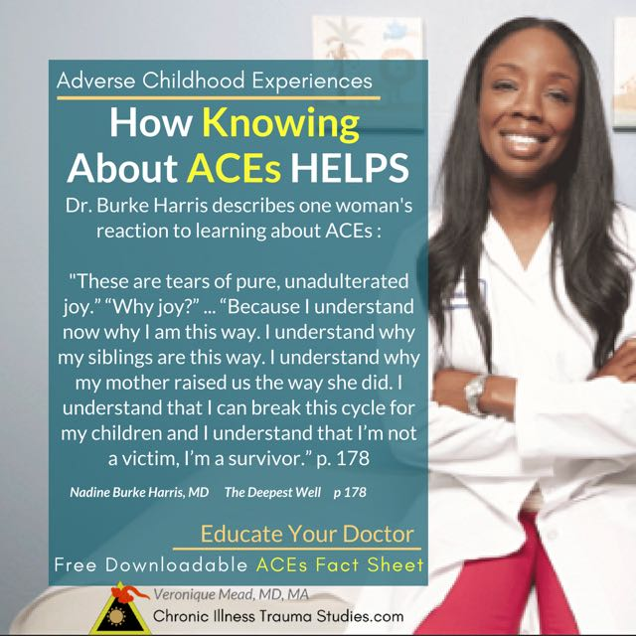
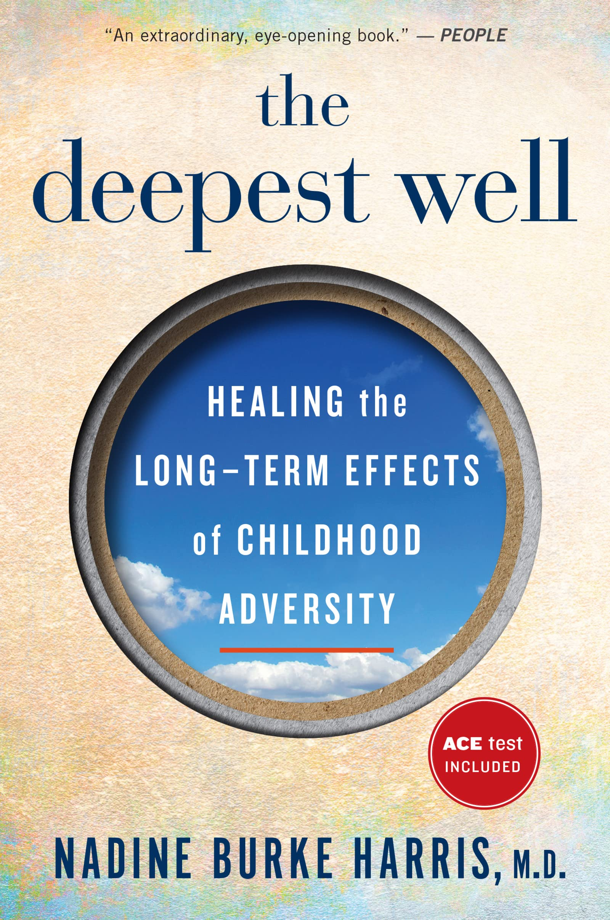
Dr. Nadine Burke Harris hypothesized that the same effect she had observed in the tadpoles was the same effect toxic stress was having on the health of her young patients.

Slide 39
Exposure to Trauma
Based on research, as well as her training, Dr. Burke Harris understood that cortisol, a stress hormone, inhibited growth, increased blood pressure, blood sugar, and produced other related effects.
These were effective strategies for short periods of time when danger was present and required a rapid response.
Notes:
Dr. Burke Harris wrote a book about this experience, The Deepest Well, which documents the implementation of Trauma-Informed Care at the Bayview Child Health Center in San Francisco.

Slide 40
Trauma Symptoms Can Be Age Dependent
“…different symptoms may result from trauma experienced at different times. For example, a toddler with no language to describe the painful and repetitive sexual abuse he experiences may develop a complete aversion to being touched, wide-ranging problems with intimacy and relationships, and pervasive anxiety. But a ten-year-old who is subjected to virtually identical abuse is more likely to develop specific, event-related fears and to work deliberately to avoid particular cues associated with the place, person and manner of abuse…Further, an older child will probably have associated feelings of shame and guilt—complex emotions mediated by the cortex.”—Bruce Perry, MD, PhD and Maia Szalavitz from The Boy Who Was Raised as a Dog

Slide 41
Maslow’s Hierarchy of Needs
Notes:
When Basic Needs are Not Met, Many of Us Fail to Thrive
A Child whose basic needs are not met will often fail to survive.

Slide 42
Our Brains Seek Safety

Slide 43
When All or Most of Our Needs are Met, Our Brains are Free to Explore.

Slide 44
The Toxic Effects of Stress
When additional grant money for the Bayview Child Health Center was obtained, Dr, Burke Harris hired a mental health therapist.
Dr. Whitney Clarke introduced her to a study performed in San Diego at Kaiser-Permanente by Drs. Vincent Felliti, Robert Anda and colleagues:
The Adverse Childhood Experiences (ACE) Study.

Slide 45
Dr. Vincent Felitti, couldn’t figure out why more than half of the people in his obesity clinic dropped out, even those who initially did well.
He began to discover that for many of his female patients, obesity was the solution to romantic interest from men, after a history of sexual abuse.
Dr. Robert Anda had been studying how depression and feelings of hopelessness affect coronary heart disease.
“I became interested in going deeper, because I thought there must be something beneath the behaviors generating them.”
Prior to their investigations, most mental health professionals believed Adverse Childhood Experiences did not affect very young children, as they were unable to recount these experiences verbally.

Slide 46
ACE STUDY 1995–1997
17,000 primarily white, middle-class adults.
Each person indicated whether any of the ten adverse experiences occurred in his or her childhood.
Only one-third reported none.
More than two-thirds had undergone at least one adverse childhood experience.
One in eight had undergone four or more.
This Photo by Unknown Author is licensed under CC BY-SA

Slide 47
The 10 Adverse Childhood Experiences
1. Emotional abuse
2. Physical abuse
3. Sexual abuse
4. Mother treated violently
5. Substance abuse in the home
6. Mental illness of a family member
7. Parents divorced/separated
8. Family member incarcerated
9. Emotional neglect
10. Physical neglect

Slide 48
Conclusion: ACEs are the leading cause of health and social problems in our nation, including:
Depression
Anxiety
Suicide
Sexual Behavior Problems
Unintended Pregnancy
Violence
Issues in the Workplace
Alcohol Dependence & Abuse
Drug Dependence & Abuse
Chronic Obstructive Lung Disease
Coronary Heart Disease
Obesity
Liver Disease
Fetal Death

Slide 49
Dr. Burke Harris identified six mitigating interventions for those with multiple ACE Scores:
Improved Sleep Hygiene
Exercise
Better Nutrition
A Mindfulness Practice
Mental Health Treatment
Healthier Relationships

Slide 50
ACE Score by Population
0 ACEs 1 ACE 2 ACEs 3 ACEs 4+ ACEs
33%
26%
16%
10%
16%
Notes:
There is a dose-response ratio with an increased level of stress and an increased set of risks.
The more ACEs reported, the greater the chance of adverse adult outcomes.

Slide 51
ACE Score and Health Problems
%
with Health Issues
Dose-Response Relationship
Notes:
Individuals who report higher ACE scores are more likely to have issues with their health and social problems.
As the ACE Score goes up, the chances of health and social issues also rise.
This is called a Dose-Response Relationship. The more ACEs, the greater the chance of related issues.

Slide 52
ACEs, Smoking and Lung Disease
%
with Health Issues
Notes:
People with higher ACE scores have increased risk of chronic obstructive pulmonary disease, or COPD.
Approximately 4% of people with an ACE score of zero developed COPD, while about 9% with an ACE score of 4 or more developed COPD.
Individuals with higher ACE scores have a greater risk of developing COPD even given similar histories of tobacco use.

Slide 53
ACEs and Depression
Dose-Response Relationship
Notes:
Depression is the leading cause of disability in developed countries.
The risk of depression increases for both men and women in a “dose-response” fashion as the ACE Score rises.

Slide 54
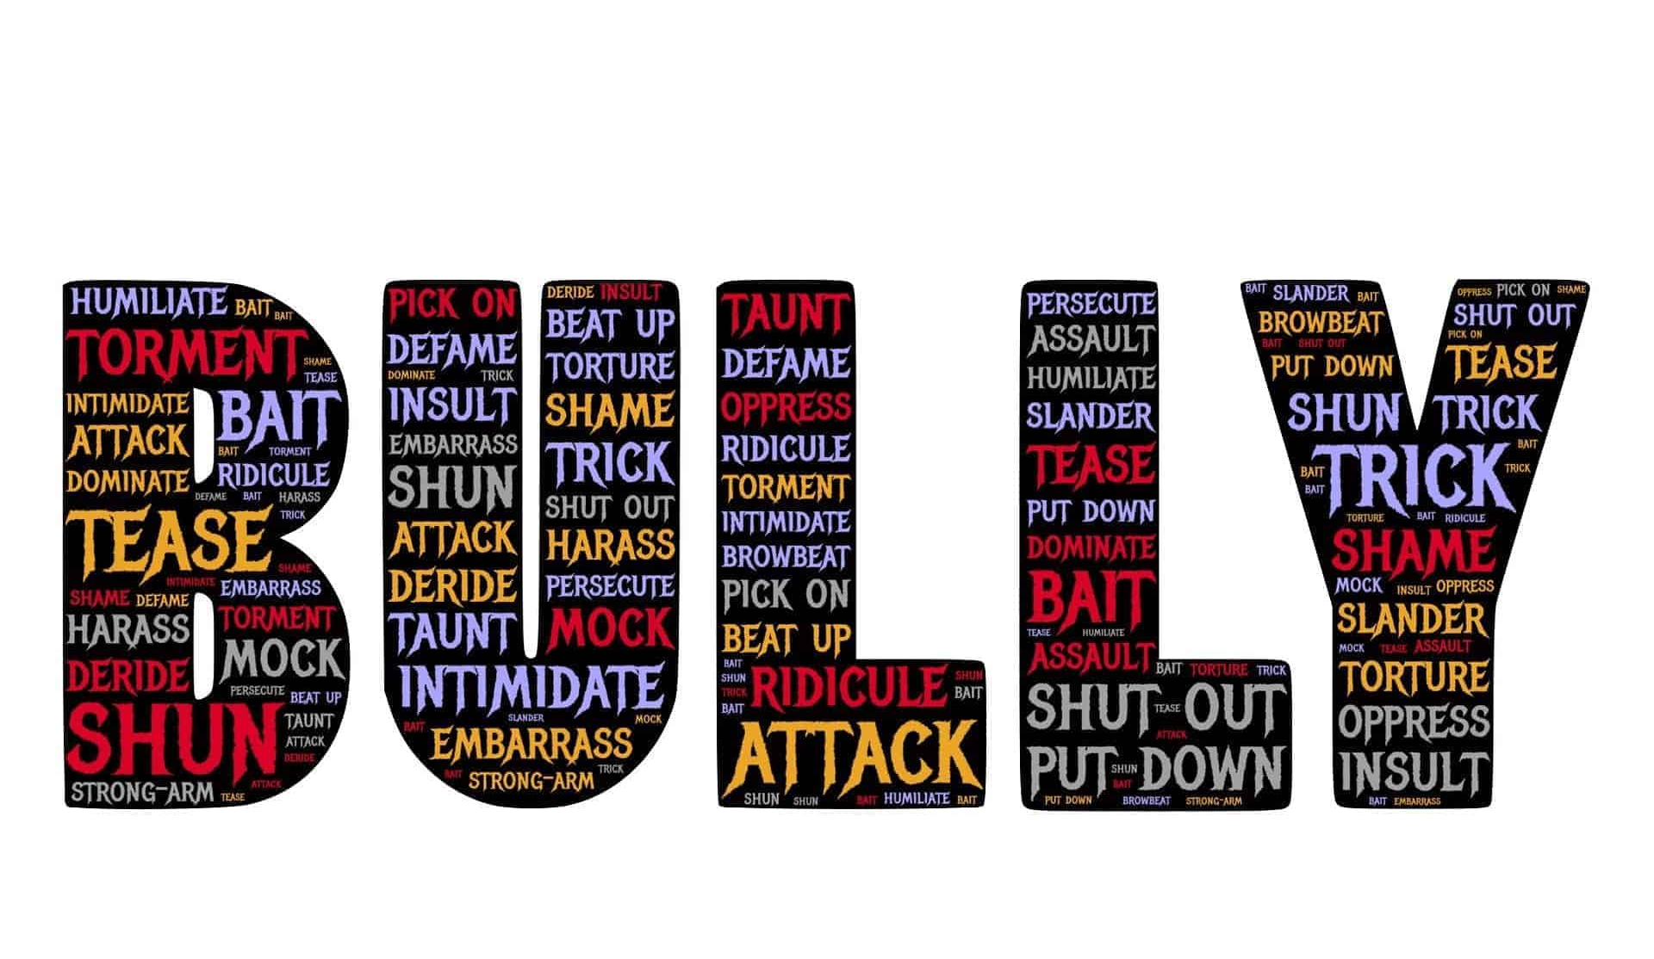
The ACE Studies measured 10 traumatic events
They did not measure bullying, community violence, natural disasters, witnessing non-domestic violence, racism, sexism, or other forms of abuse, isolation or discrimination.
Notes:
While the original ACE Questions were revealing and enlightening in their prevalence, other factors also create toxic stress. According to a recent study on behalf of the Society of Biological Psychiatry, Racism is a chronic stressor fueled by stigma that can result in significant distress and dysfunction as well as negatively affect emotions, behavior, quality of life, and brain health. The effects of stigma and discrimination emerge early in life, with long-term consequences.

Slide 55
Gabor Maté, M.D.: Trauma is more common than you may think

Slide 56
Building Adult Capabilities

Slide 57
When Traumatized Children Grow Up
They may be quick to react
Any sudden noise or gesture may elicit intense fear.
They may appear reactive, which can be interpreted as aggression.
They may appear dysregulated at times: angry, yelling or crying.

Slide 58
When Traumatized Children Grow Up
They may have issues with concentration
Concentration requires focus and safety.
Traumatized people rarely feel safe, even years later.
They may have difficulty connecting with others
Traumatized people often find it hard to trust.

Slide 59
In the Workplace
People with a trauma history will likely become easily frustrated.
Kindness toward them will triumph discipline almost always!

Slide 60
At Walmart
Individuals with a trauma history are often uncomfortable in crowded situations
They may have difficulty waiting their turn in a line.
They may have difficulty with making decisions, especially when faced with numerous choices.
They may find the layout of the store difficult to navigate.

Slide 61
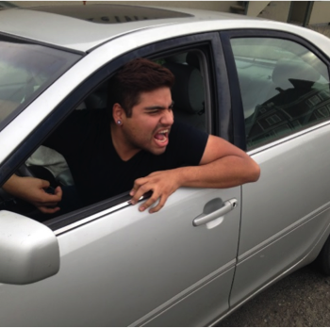
On the Road
Persons with a trauma history can become dysregulated
Trapped in a traffic jam may trigger familiar memories of being restrained, or in an abusive relationship.
Escalation can occur quickly.

Slide 62
In the history of calm down, no one has ever calmed down by being told to calm down.

Slide 63
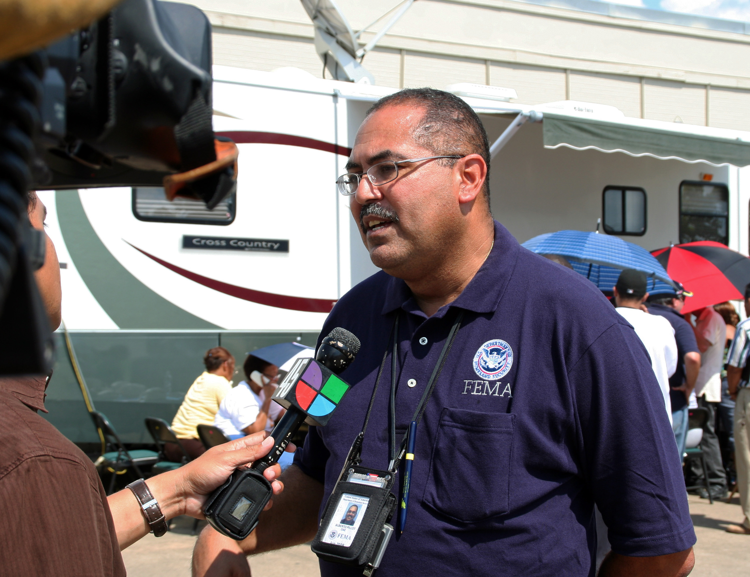
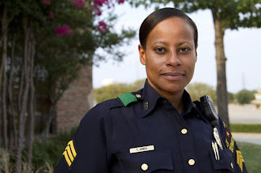
In Some Arenas those of us with Multiple ACE Scores will Thrive
This Photo by Unknown Author is licensed under CC BY-SA-NC
Notes:
What kind of situations might be a good match for a person who tends to be edgy, hypervigilant, emotionally detached, or quick to act?
How might these kinds of adaptations be useful in this environment?
One common belief in our society is that the people with one type of experience are maladaptive and people with another type of experience are adaptive.
The reality is that both pathways are adaptive.
Both brains are adapting to their experience.
First responders including EMTs, Firefighters and Police Officers who have been exposed to childhood ACEs often do well in these high stress worlds.

Slide 64
The Benefits of Adversity
Studies of trauma survivors demonstrate adversity can have benefits called posttraumatic growth.
The experience of positive change that occurs as a result of struggling with challenging life crises can have certain benefits:
Help you see you’re stronger than you thought
Bring new appreciation and meaning to your life
Change your priorities
Take you deeper into your spirituality
Deepen the closeness you feel toward yourself and others

Slide 65
If We Could Eliminate Adverse Childhood Experiences We Would
Reduce the overall rate of depression by more than half
Reduce alcoholism by two-thirds
Reduce suicide, IV drug use, and domestic violence by three-quarters.
It would have a dramatic effect on workplace performance
It would vastly decrease the need for incarceration.

Slide 66
Trauma-Informed Design
“Trauma-informed design” explores ideas for built environments that support the tenets of trauma-informed care.
The physical environment has an impact on attitude, mood, and behavior.
There is a strong link between our physiological state, our emotional state, and the physical environment.

Slide 67
Creating A Trauma-Informed Environment
Colors
Cool colors such as blue, green, and purple have a calming effect.
Lighter-colored rooms are perceived as more open, less crowded and more spacious, providing a safer and more calming space.

Slide 68
Creating A Trauma-Informed Environment
Furniture
An open space with clear sightlines and few barriers can further increase the sense of safety.
Seating arranged to increase socialization
Using natural materials and colors increases connection to nature and a sense of calm.
Rooms bright with natural light appear less crowded.

Slide 69
Creating A Trauma-Informed Environment
Plants, Flowers and Greenery
Settings which include vegetation reduce stress, promote peace, tranquility, enhanced self-esteem, and a sense of mastery of the environment.
Art
Art adds visual interest and can create a visual distraction that alleviates stress, improves mood, comfort and satisfaction.

Slide 70
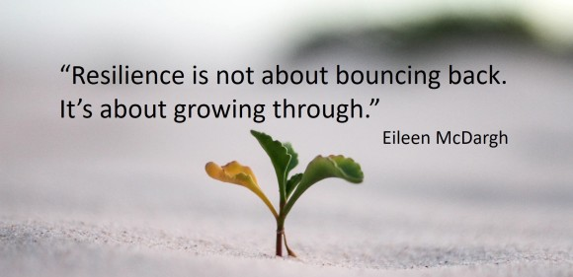
Empowerment
Help ensure opportunities are available for all. Opportunity empowers!

Slide 71
Trauma-Informed Starts with You!

